Slide 1
Bitcoin and the Byzantine Problem
Group 11
Notes:
What is the Byzantine Problem?

Slide 2
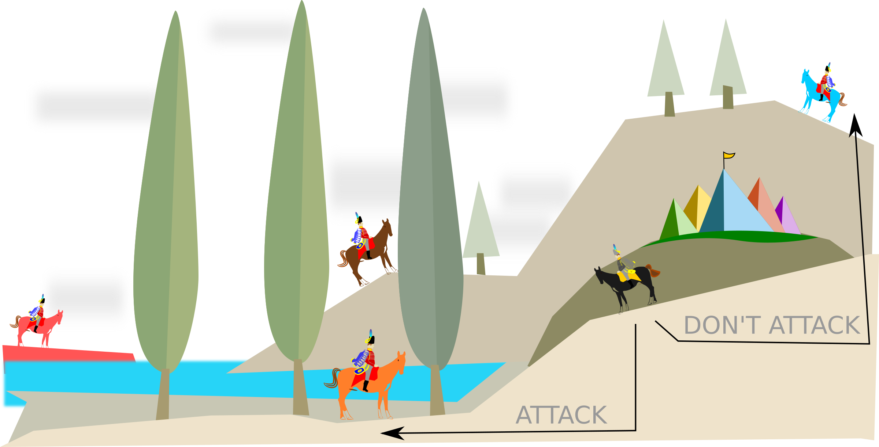
Byzantine Problem
Logical dilemma researched by Leslie Lamport, Robert Shostak, and Marshall Pease
Group of Byzantine generals and armies that must launch a successful attack with one, unknown bad actor in their system
Generals must only decide whether to attack or retreat. They must agree on a common decision.

Slide 3
Byzantine Problem in Distributed System
In a computer network:
A group making a collective decision about an action with a risk that traitors within the group may send mixed messages
Causes problems in coordinating an action effectively
Rogue or unreliable actors can cause the environment to break apart
A distributed computing environment has to be designed to solve the Byzantine general’s problem by providing a BFT (Byzantine Fault Tolerance)
Byzantine fault: Any fault presenting different symptoms to different observers
Byzantine failure: The loss of a system service due to a Byzantine fault in systems that require consensus

Slide 4
Byzantine Fault Tolerance solutions
Reduce the problem to a “Commander and Lieutenants”
Scenario where messages may be forged.
As long as the the number of traitorous generals do not equal or exceed one third of the generals.
How many Byzantine node failures can a system survive?
n = # of generals; t = # of traitors; n > 3t
No solution for n = 3
Unforgeable Message Signatures
Security-Critical Systems: Digital Signatures
Safety-Critical Systems: simple error detecting codes, CRC
Notes:
Variation of the above two allowing BFT behavior in some situations where not all generals can communicate directly with each other

Slide 5
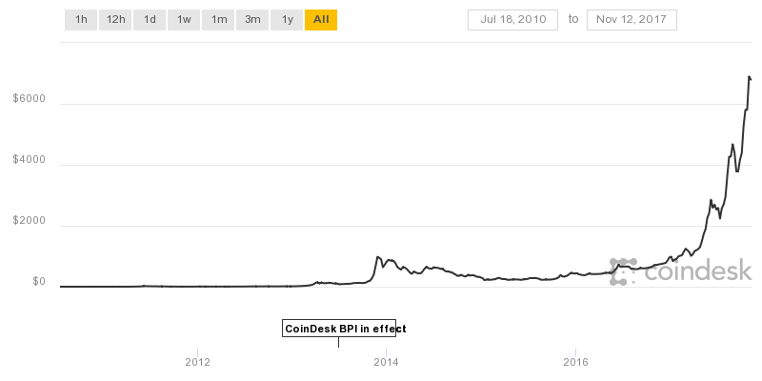
What are Bitcoins?
Founded by Satoshi Nakamoto(Anonymous name) and released in 2009
Worldwide Cryptocurrency and digital payment system
First decentralized digital currency system
Vendors such as Bitstamp, Mt. Gox, and BitInstant offer exchange services
Initially bitcoin had no value, 2010 it was valued at $0.01, in 2012 it was $2, and in 2014 it was at $600 and now it is >$6k

Slide 6
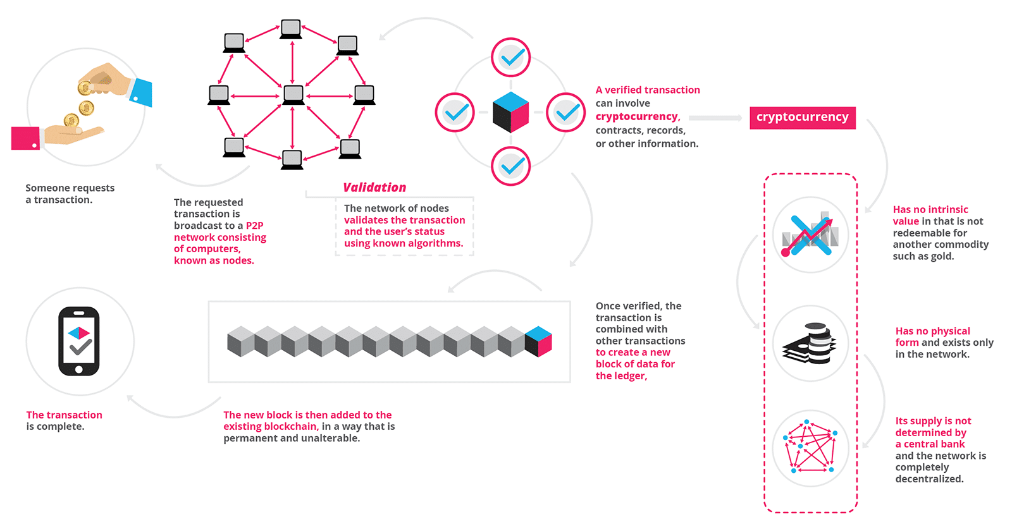
How do Bitcoins work?
You can mine or purchase bitcoins. To make a transaction, the user would request, which would be validated, and then added to bitcoin's blockchain.

Slide 7
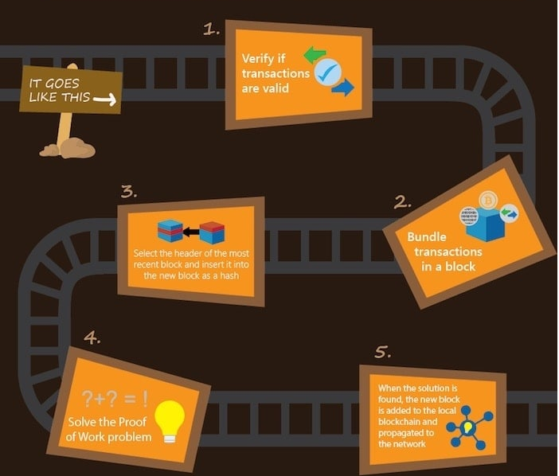
BlockChain and Mining
Proof of Work:
Create new block which contains a hashed value of:
Header of most recent block
Nonce
This value is compared to a target(256-bit number)
If the hash is less, the Proof of Work problem is solved, and the mining reward is returned
Else the process repeats

